Slide 1
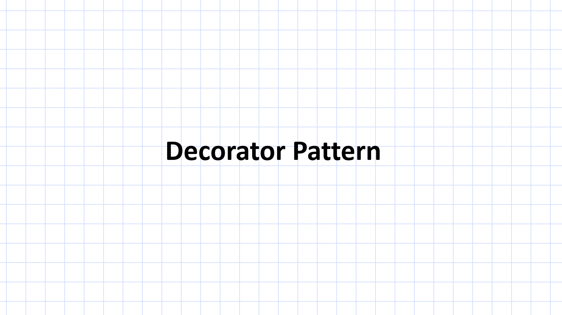

Slide 2
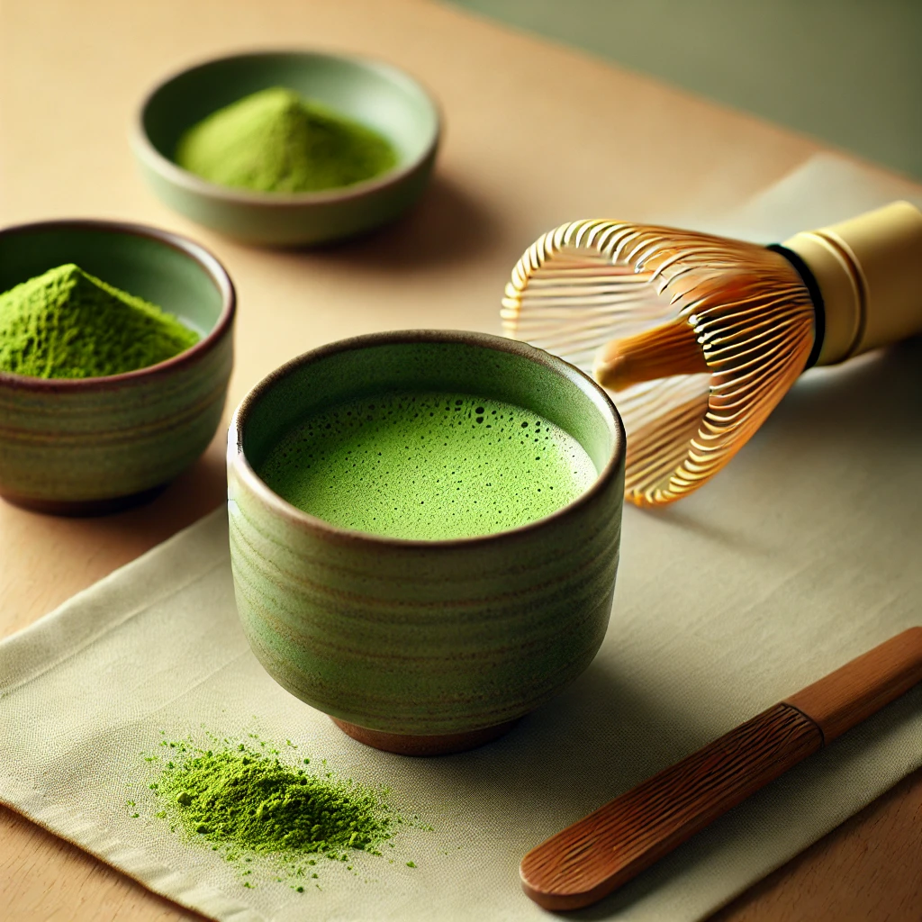
Decorator Pattern

Slide 3
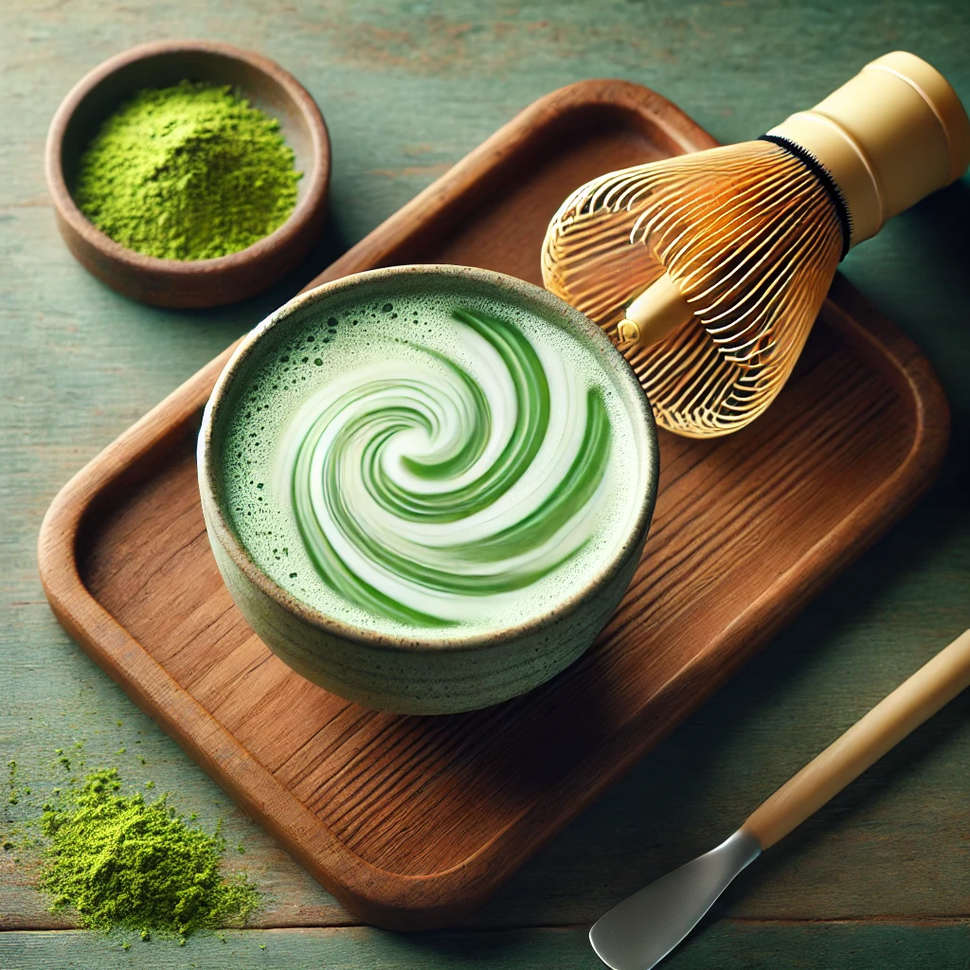

Slide 4
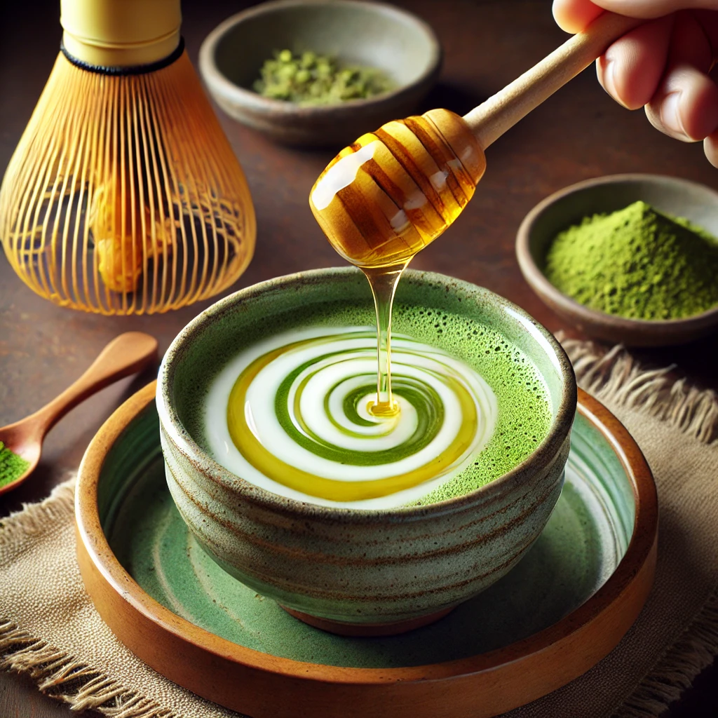


Slide 5
Decorator Pattern
Decorator #1
Decorator #2
Base Object
Decorator #3

Slide 6


Decorator Pattern

Slide 7
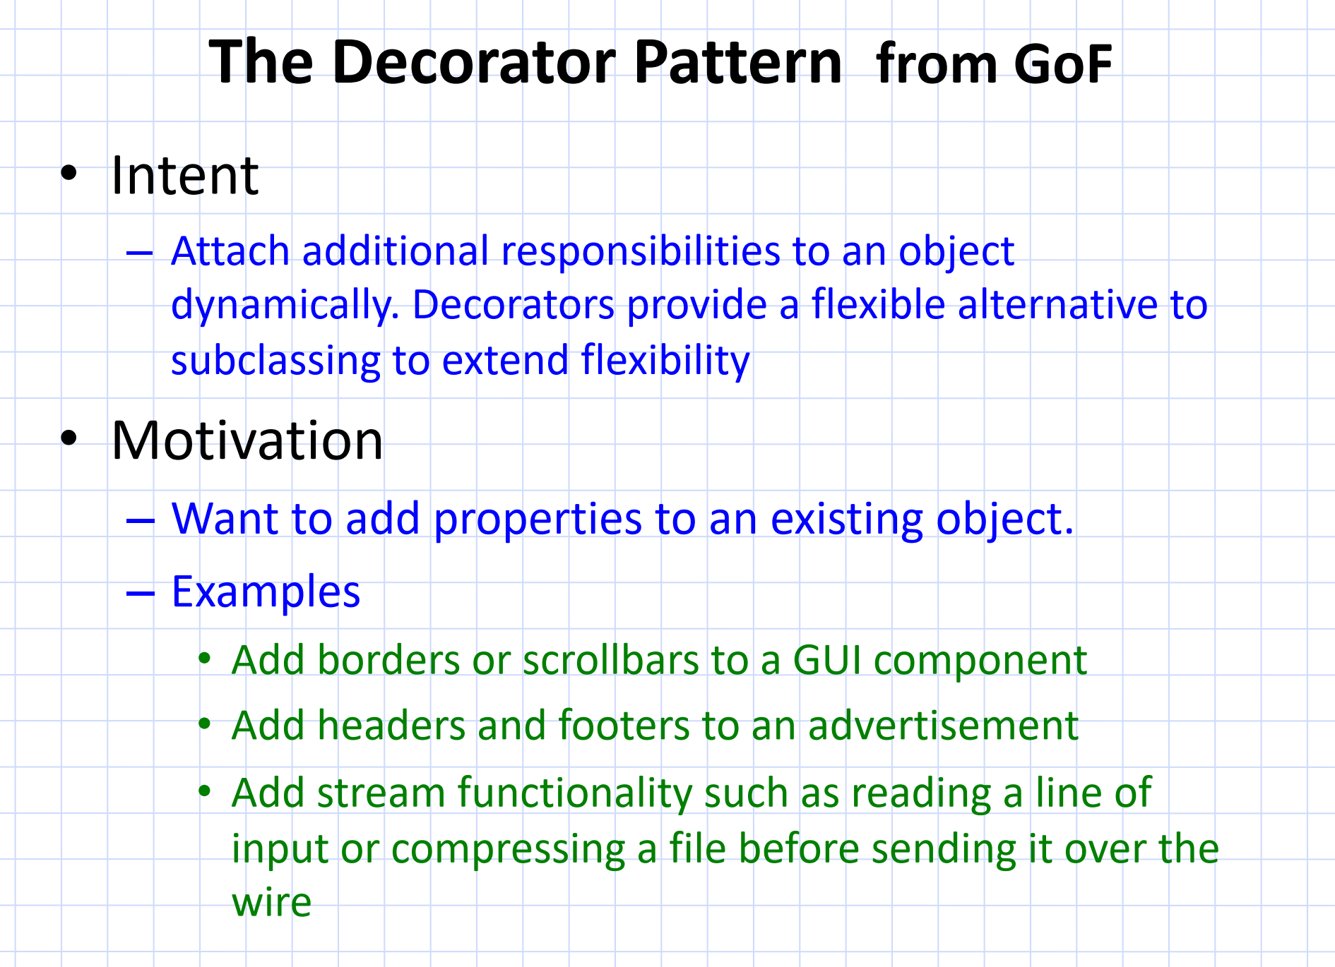

Slide 9
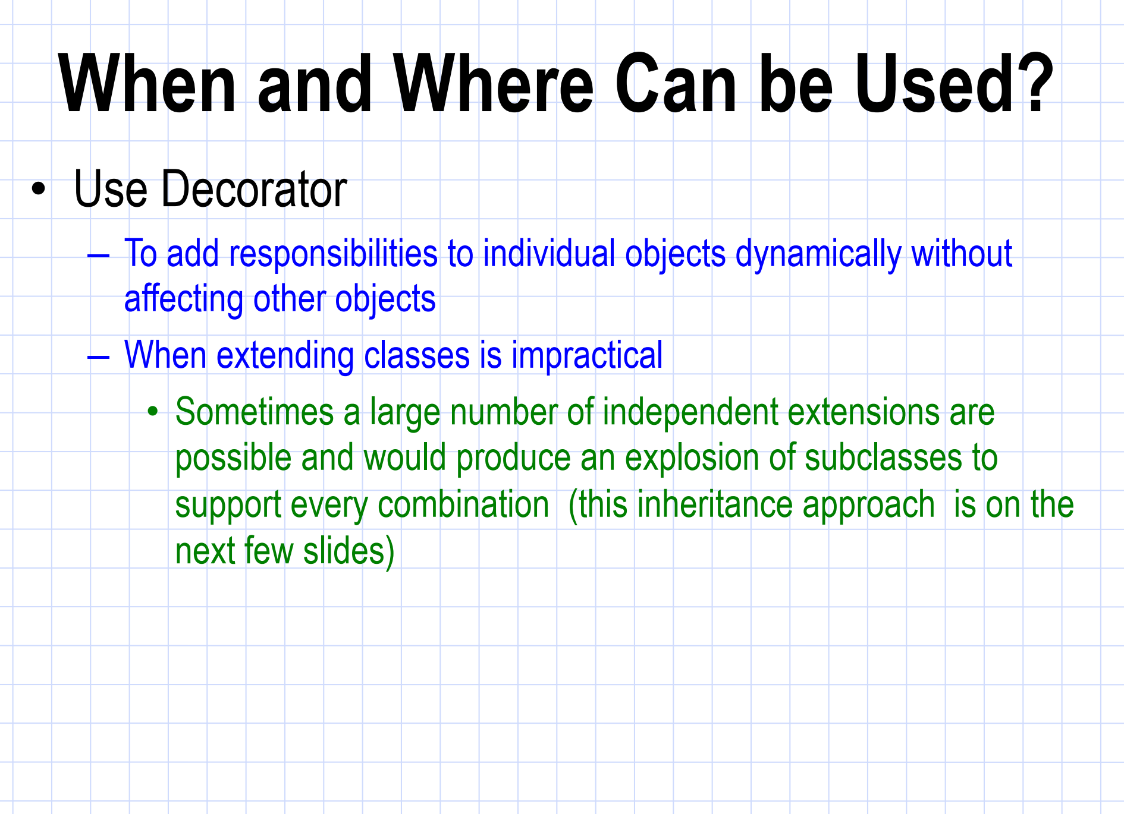

Slide 10


Slide 11
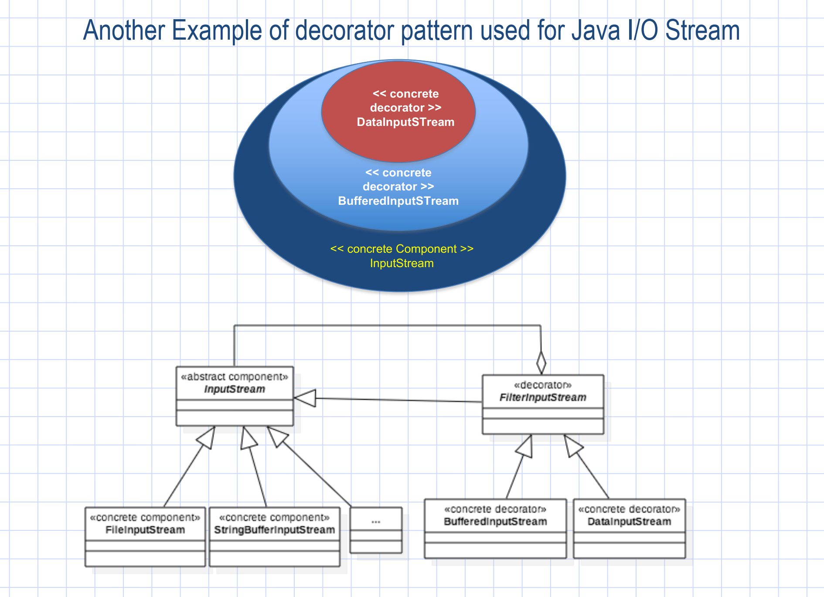
InputStream fileStream = new FileInputStream("example.txt");
InputStream bufferedStream = new BufferedInputStream(fileStream);
DataInputStream dataStream = new DataInputStream(bufferedStream);
int data = dataStream.readInt(); stream

Slide 12
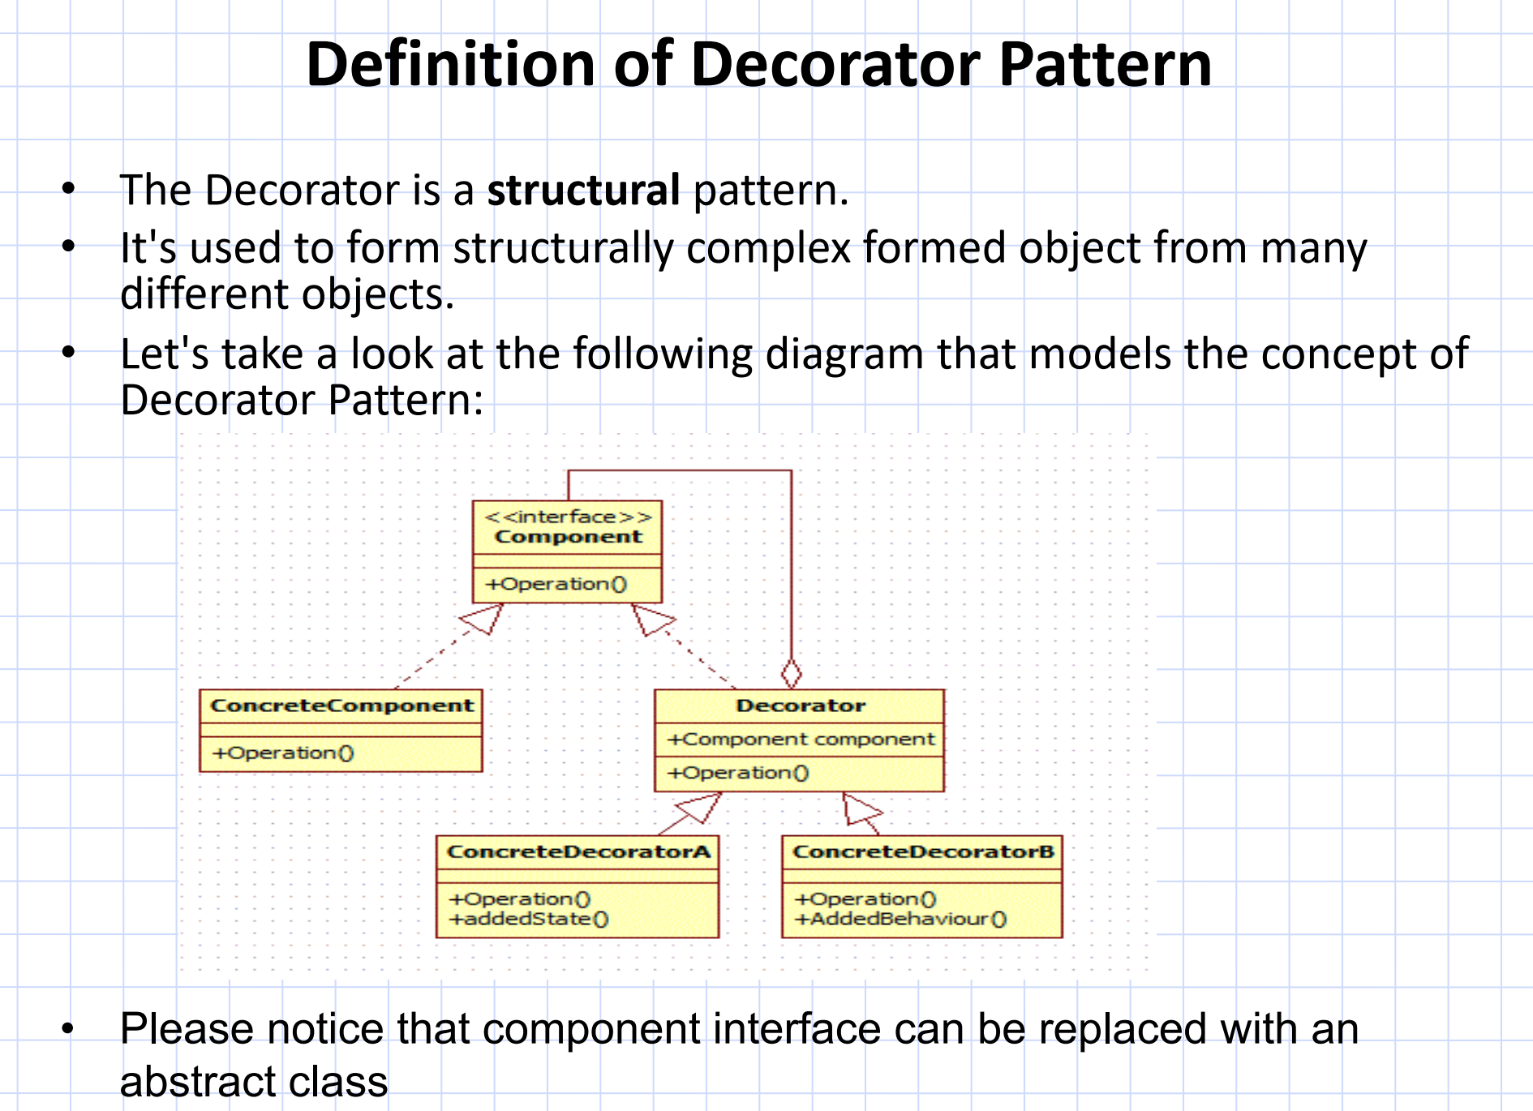

Slide 13
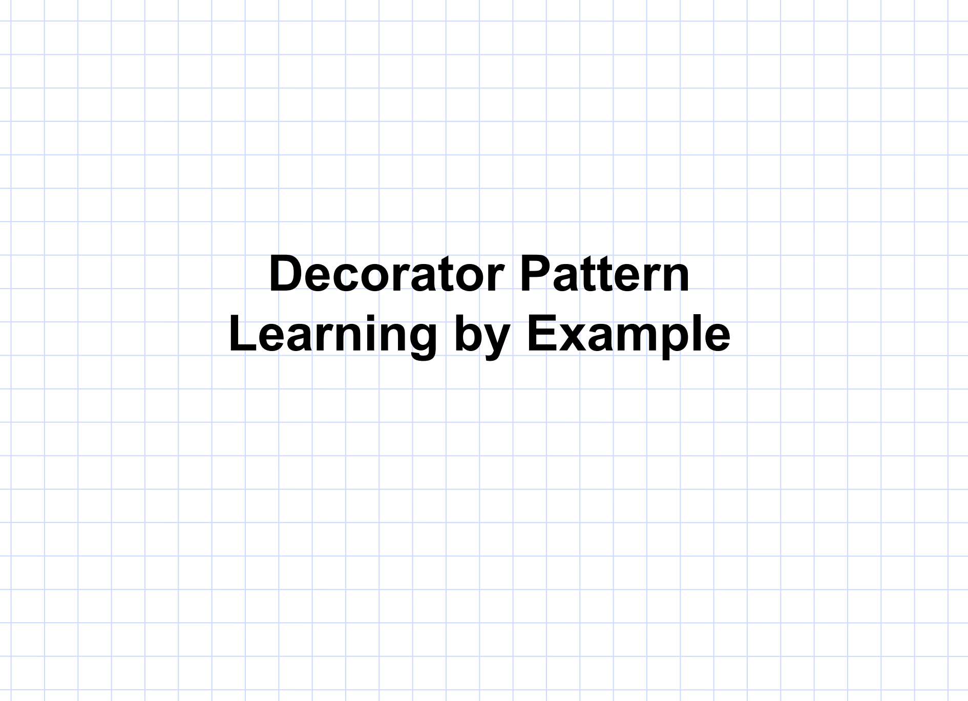

Slide 14

Component Interface (Tea)
class Tea {
public:
virtual ~Tea() = default;
virtual std::string description() const = 0; // Pure virtual function for description
virtual double cost() const = 0; // Pure virtual function for cost
};

Slide 15
Concrete Component (Matcha)
class Matcha : public Tea {
public:
std::string description() const override {
return "Matcha Tea";
}
double cost() const override {
return 3.00;
}
};

Slide 16

Decorator Abstract Class (IngredientDecorator)
class IngredientDecorator : public Tea {
protected:
std::shared_ptr<Tea> tea; // Holds the tea to be decorated
public:
IngredientDecorator(std::shared_ptr<Tea> t) : tea(t) {}
};

Slide 17

Concrete Decorators
class Honey : public IngredientDecorator {
public:
Honey(std::shared_ptr<Tea> t) : IngredientDecorator(t) {}
std::string description() const override {
return tea->description() + ", Honey"; // Adds Honey to description
}
double cost() const override {
return tea->cost() + 0.50; // Adds Honey's cost
}
};

Slide 18
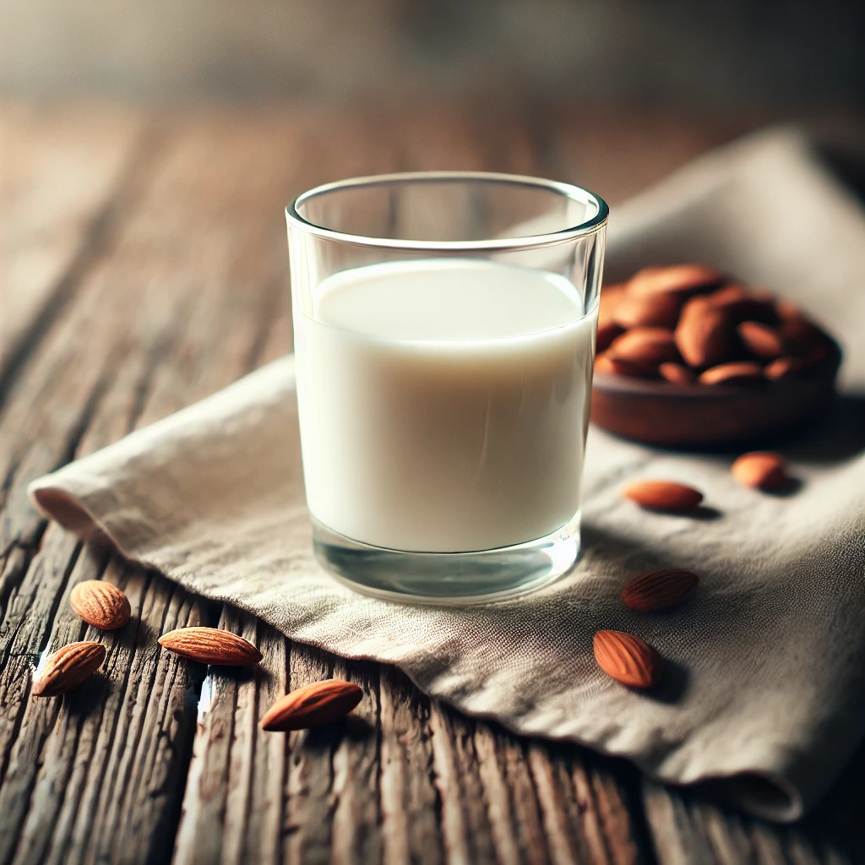
Concrete Decorators
class AlmondMilk : public IngredientDecorator {
public:
AlmondMilk(std::shared_ptr<Tea> t) : IngredientDecorator(t) {}
std::string description() const override {
return tea->description() + ", Almond Milk"; // Adds Almond Milk to description
}
double cost() const override {
return tea->cost() + 0.75; // Adds Almond Milk's cost
}
};

Slide 19
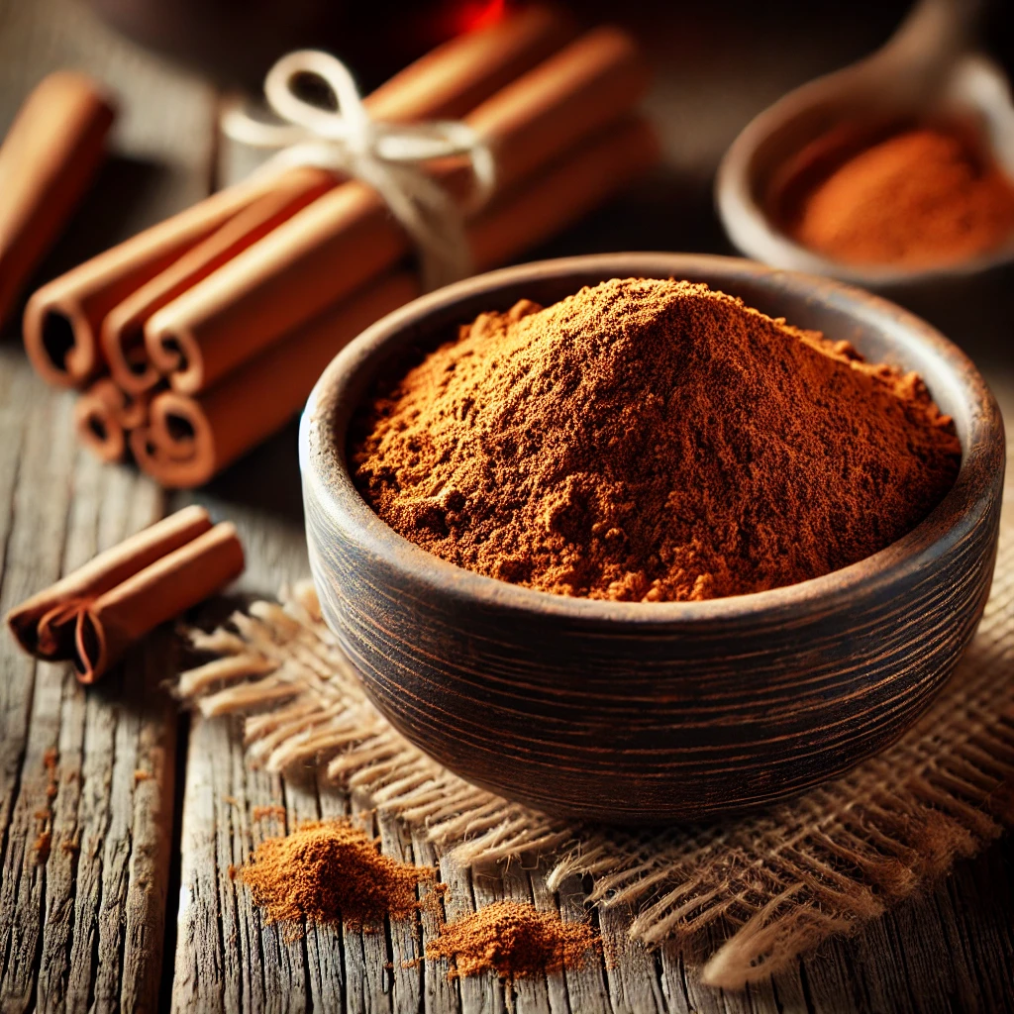
Concrete Decorators
class Cinnamon : public IngredientDecorator {
public:
Cinnamon(std::shared_ptr<Tea> t) : IngredientDecorator(t) {}
std::string description() const override {
return tea->description() + ", Cinnamon"; // Adds Cinnamon to description
}
double cost() const override {
return tea->cost() + 0.25; // Adds Cinnamon's cost
}
};

Slide 20
Decorated Tea
int main() {
std::shared_ptr<Tea> myTea = std::make_shared<Matcha>(); // Start with plain Matcha Tea
myTea = std::make_shared<Honey>(myTea); // Add Honey
myTea = std::make_shared<AlmondMilk>(myTea); // Add Almond Milk
myTea = std::make_shared<Cinnamon>(myTea); // Add Cinnamon
std::cout << "Order: " << myTea->description() << "\n"; // Output: Matcha Tea, Honey, Almond Milk, Cinnamon
std::cout << "Cost: $" << myTea->cost() << "\n"; // Output: Total cost with all add-ons
return 0;
}

Slide 21
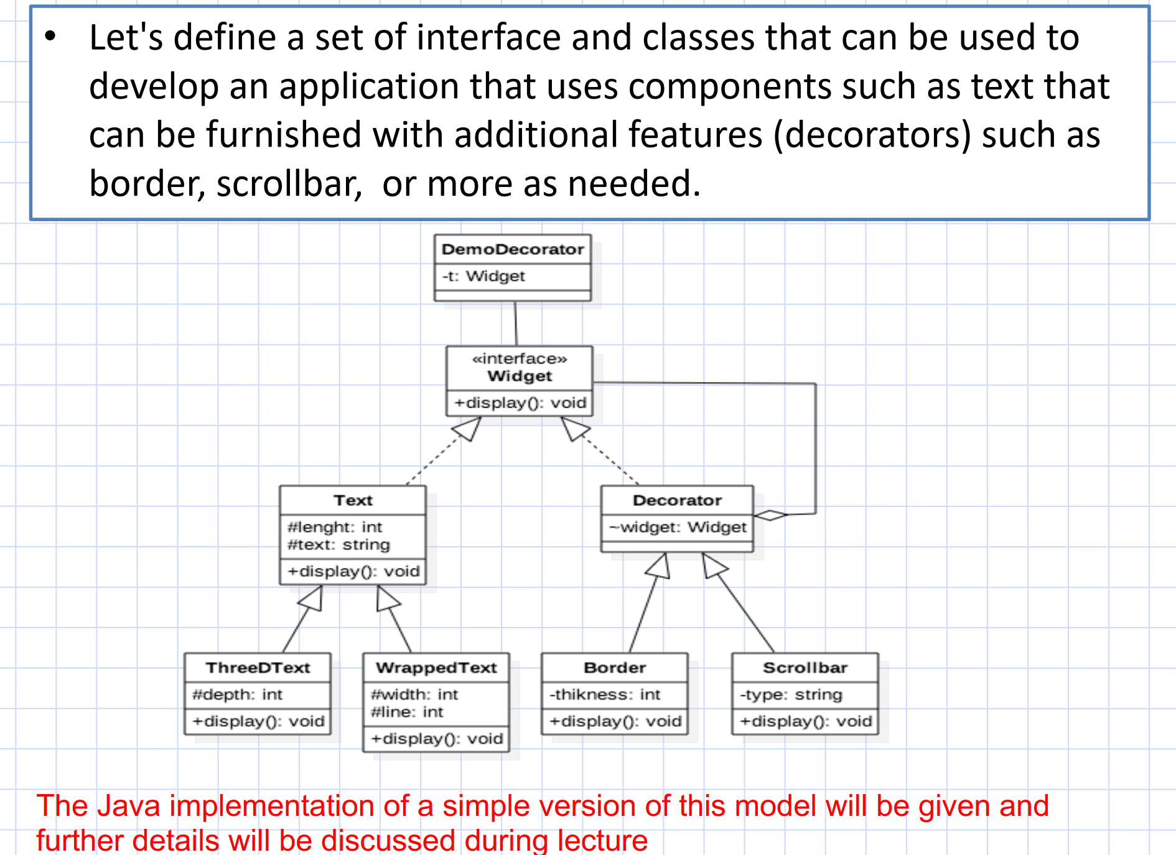

Slide 22


Slide 23
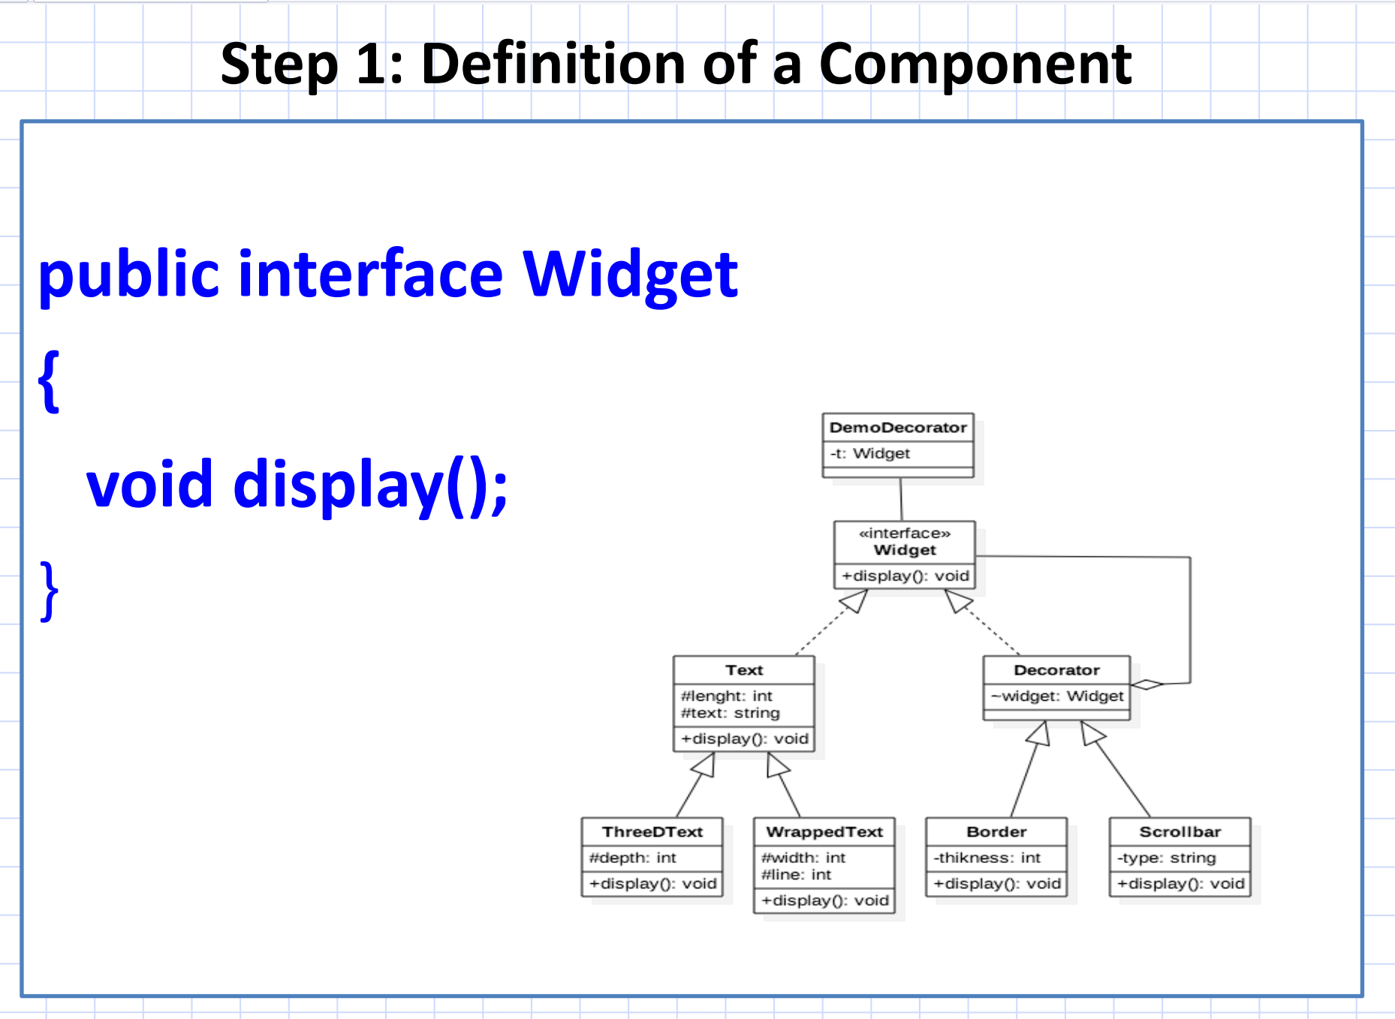

Slide 24
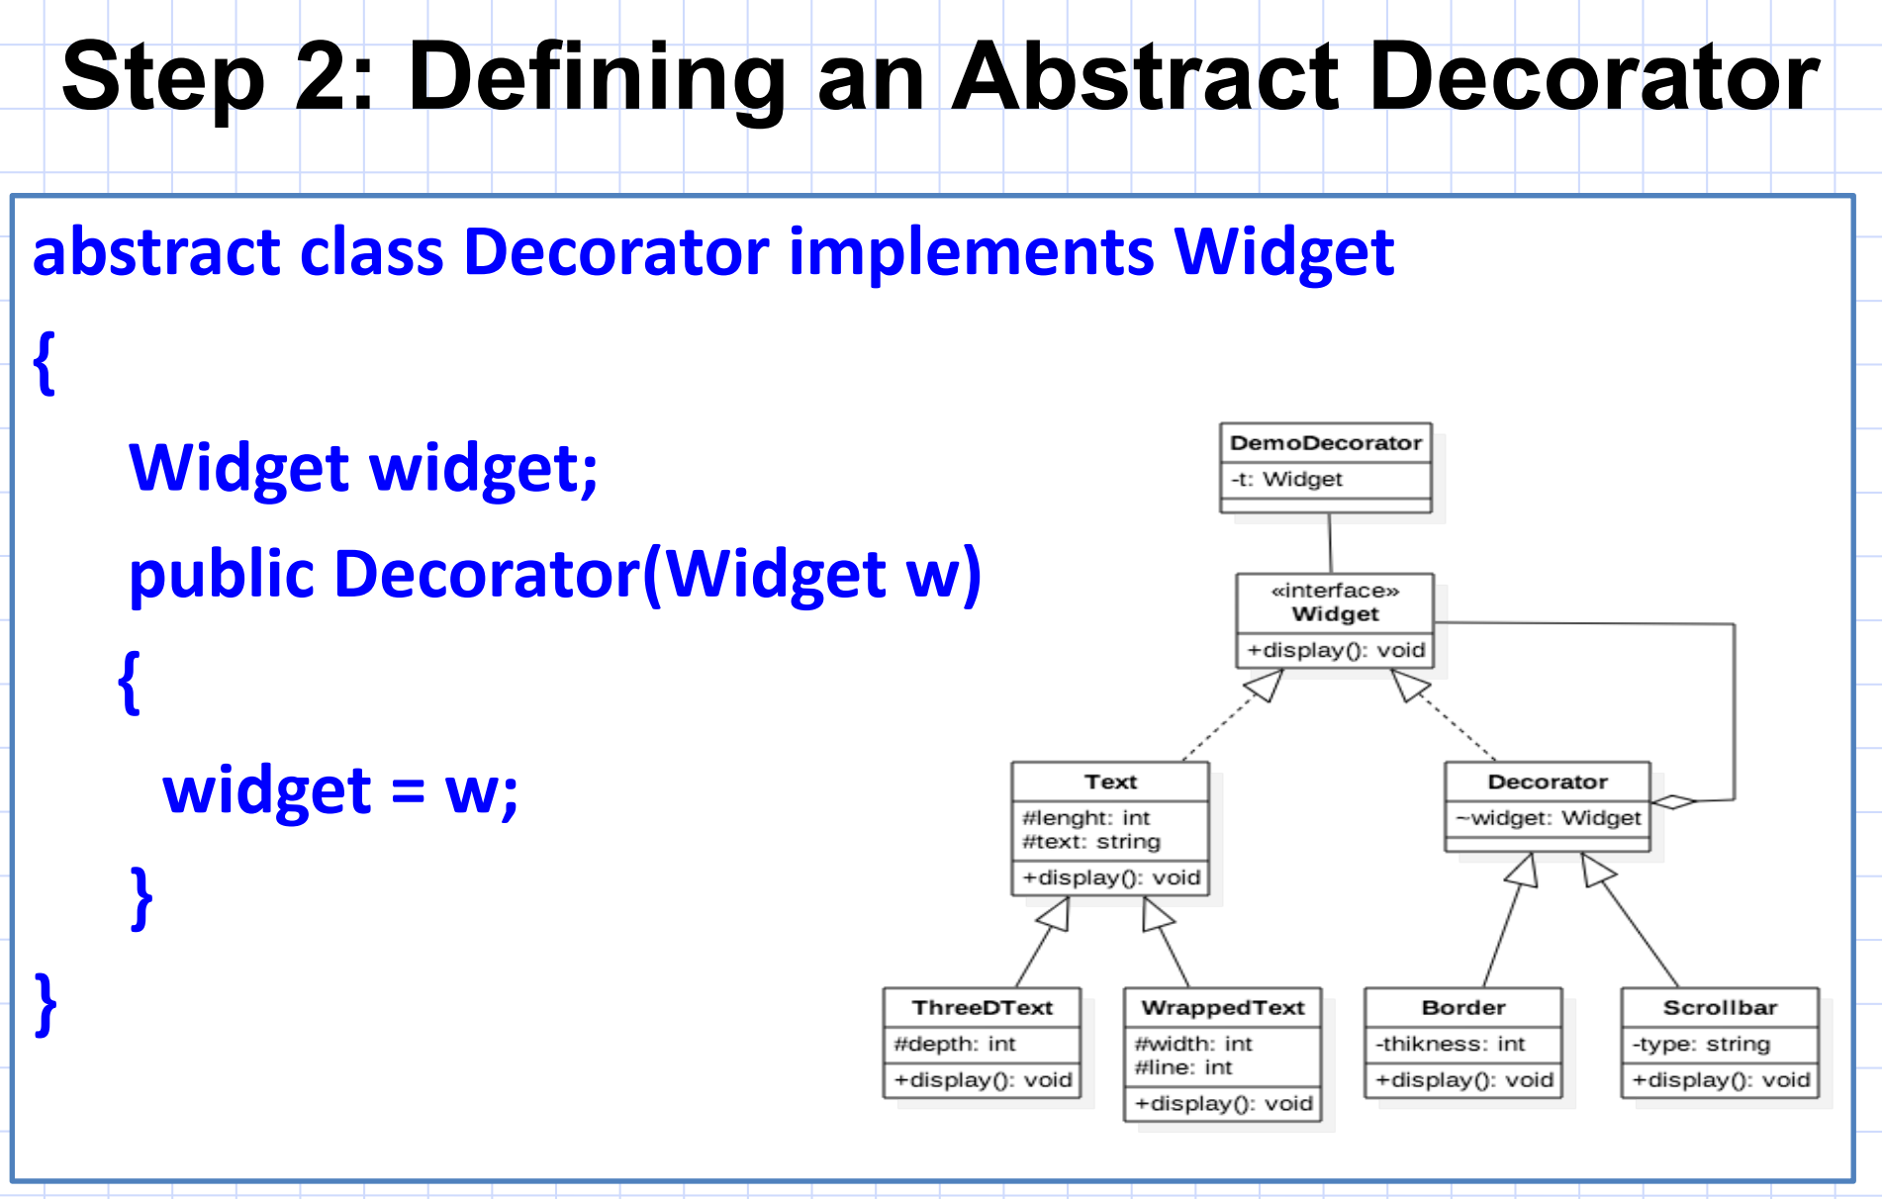

Slide 25
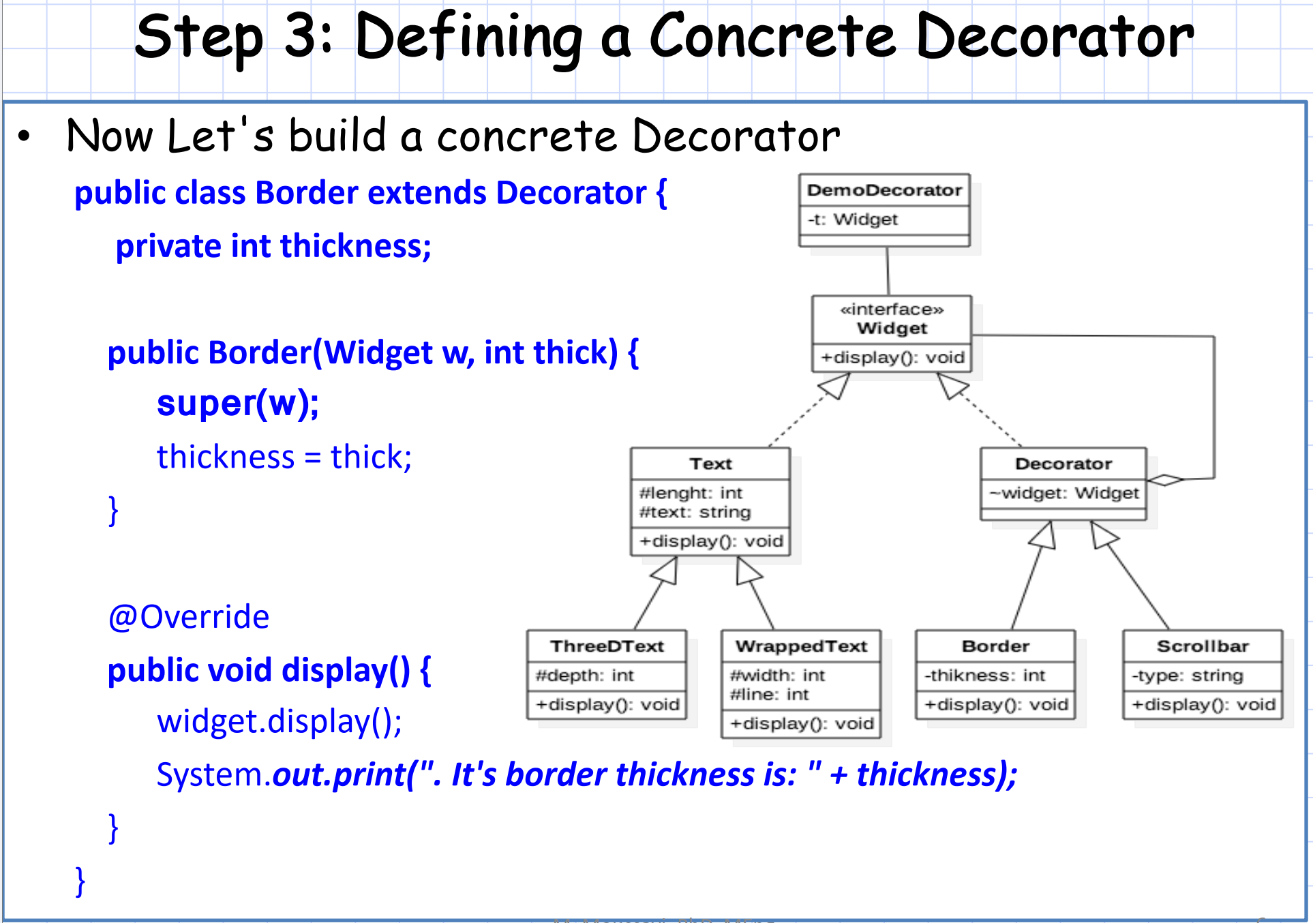

Slide 26
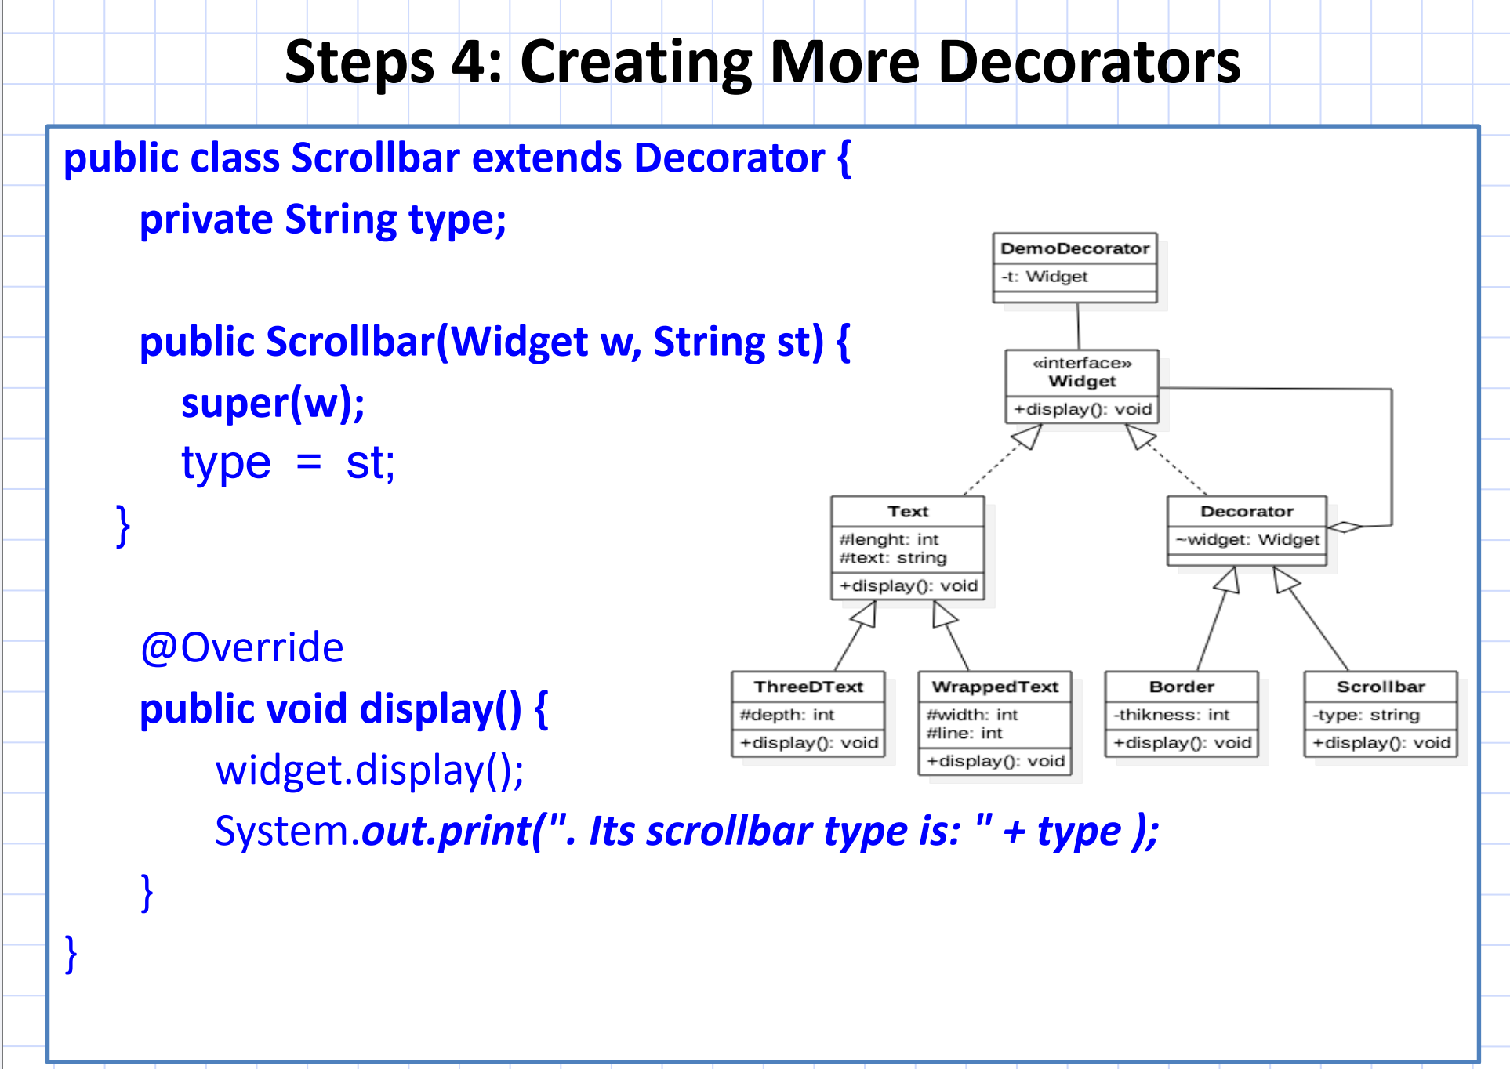

Slide 27
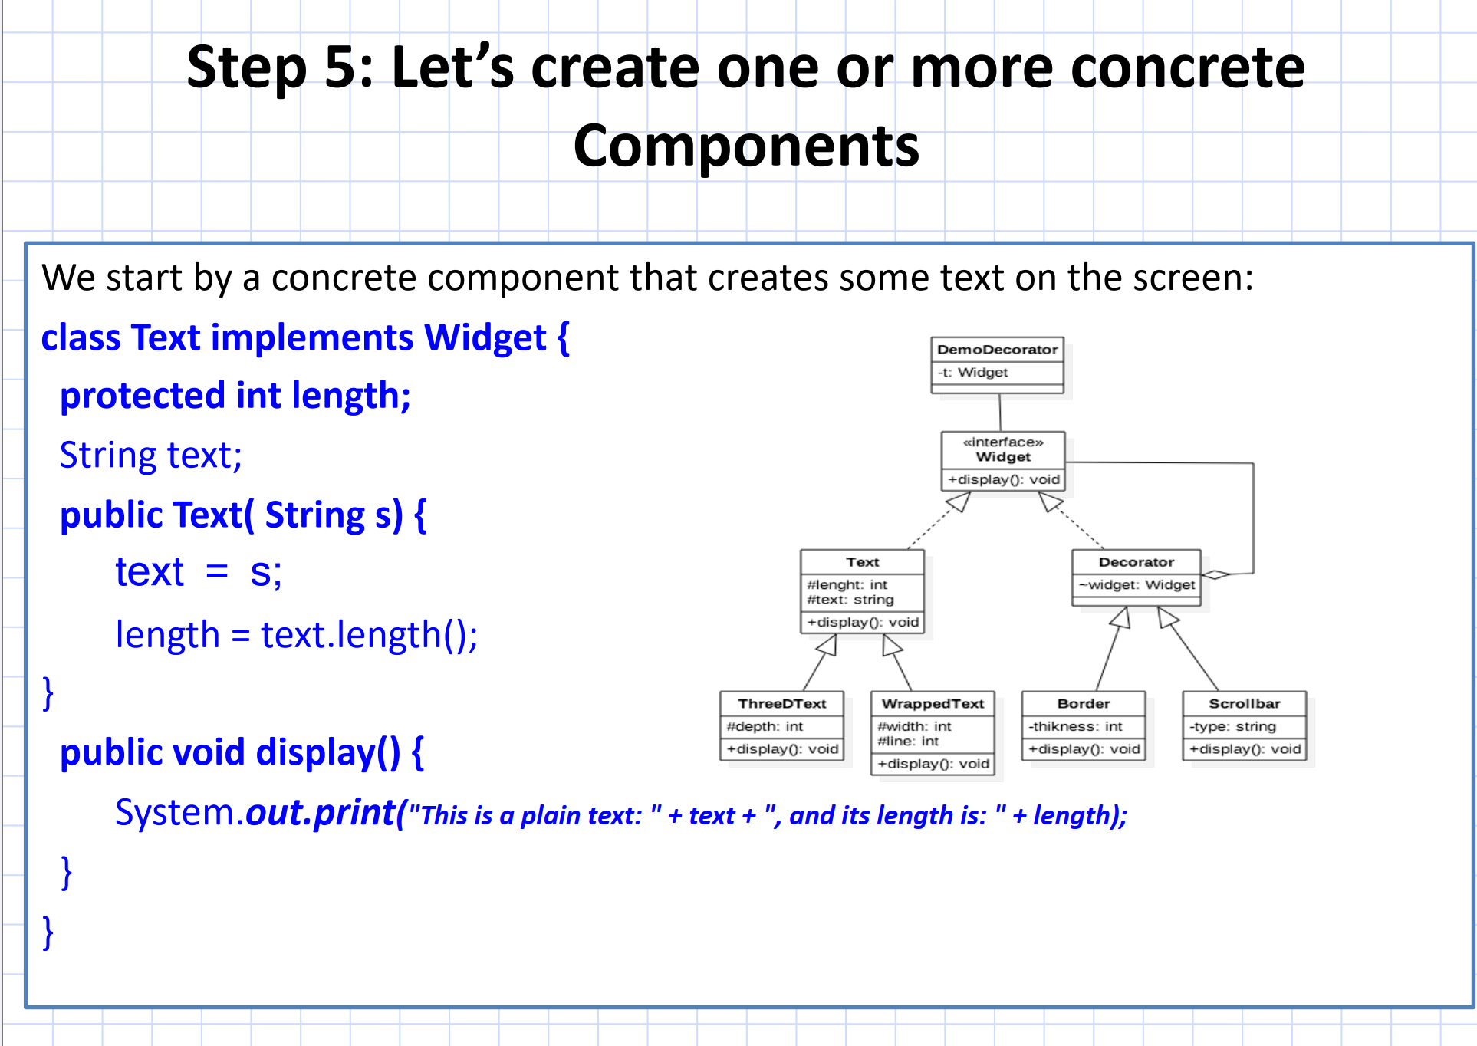

Slide 28
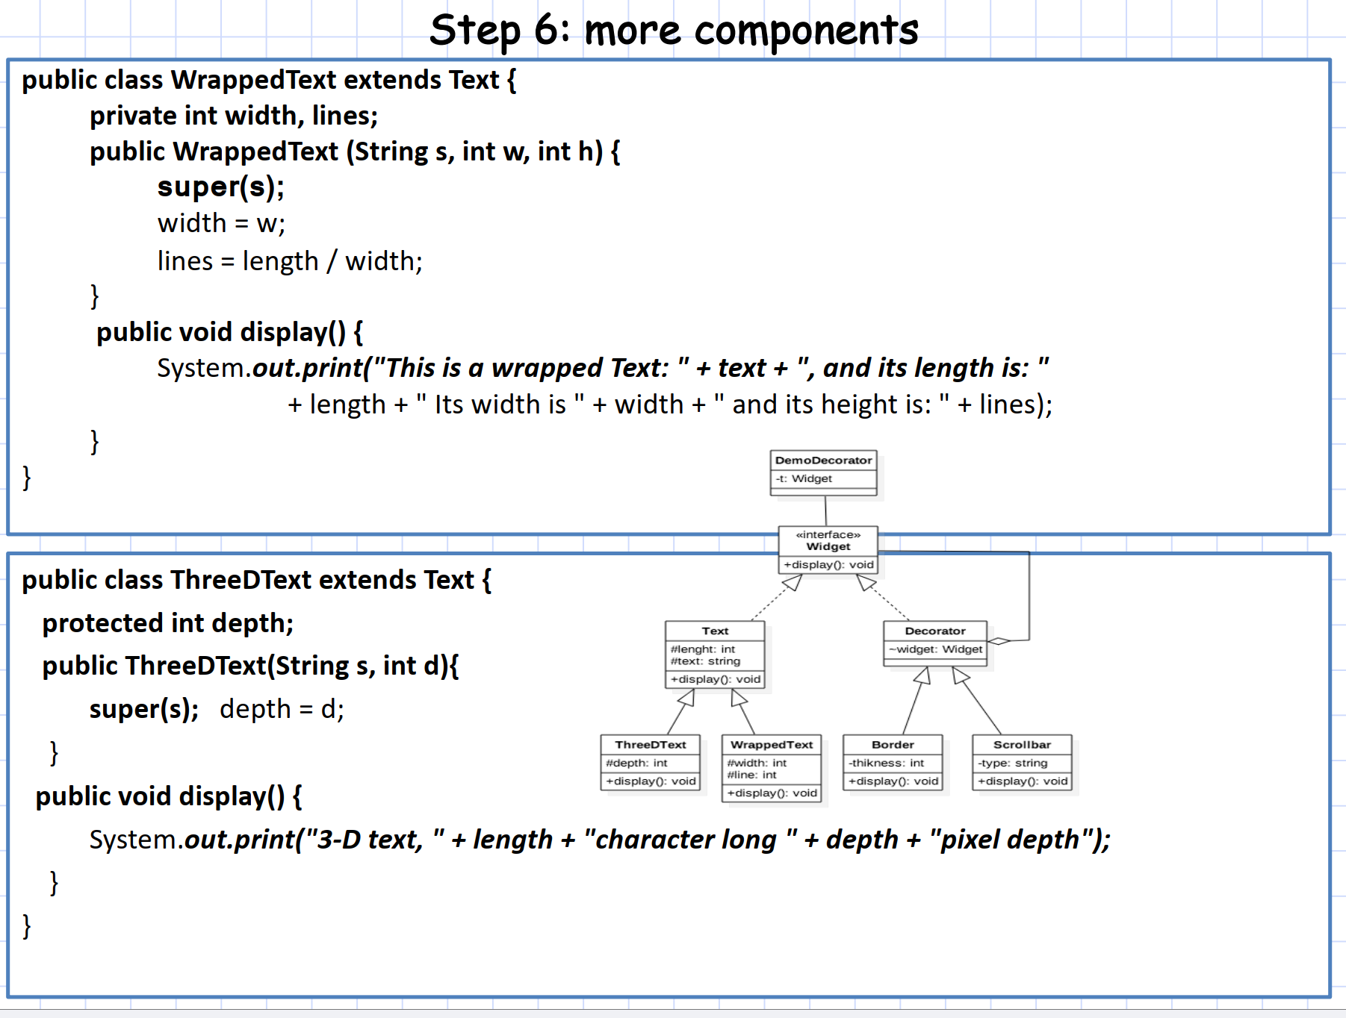

Slide 29
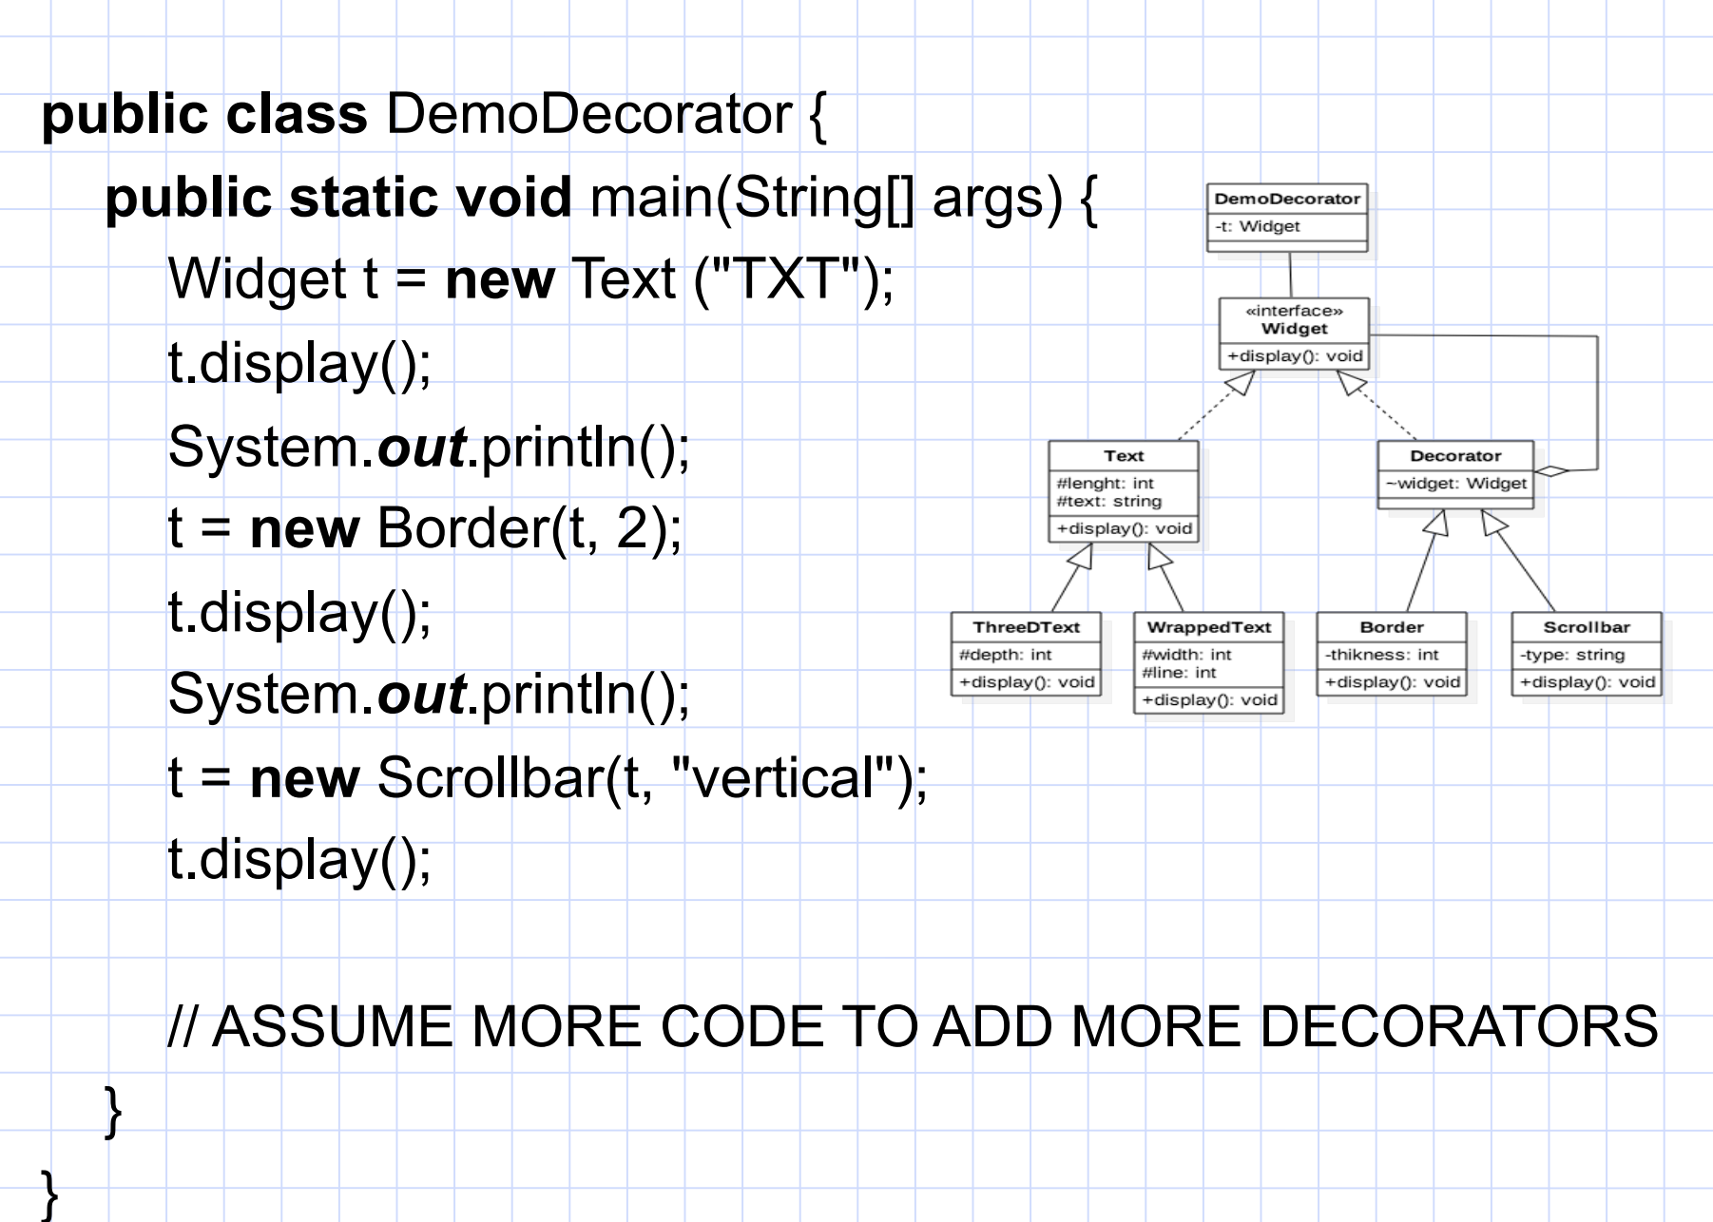

Slide 30
